Slide 1
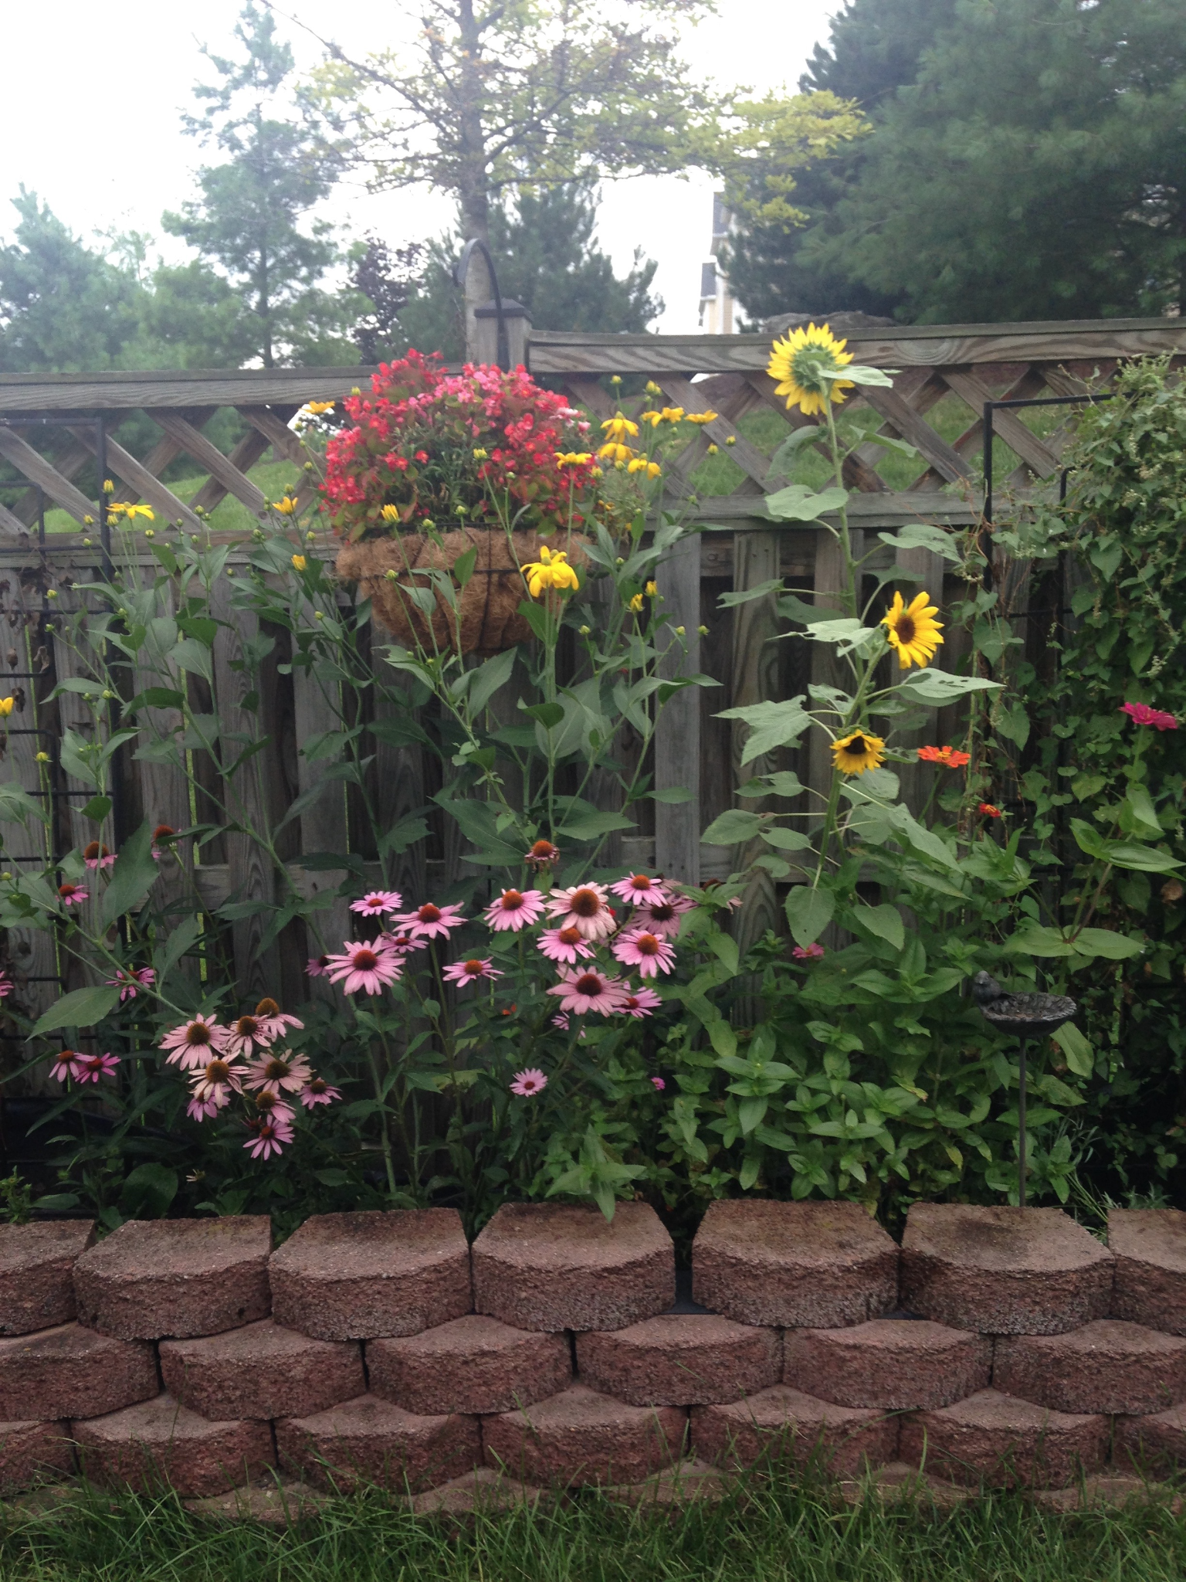
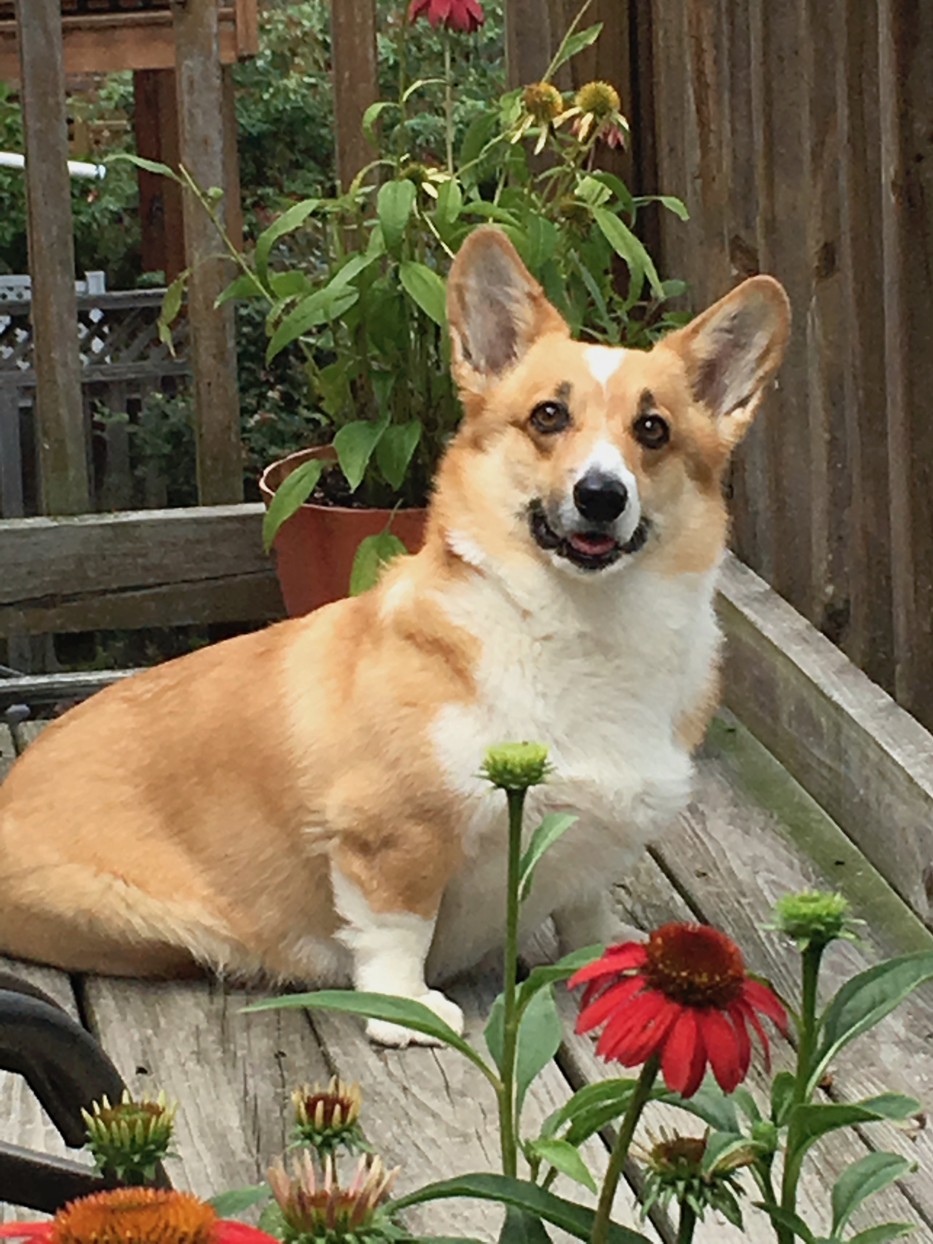
Susan Mertins
Senior Investigator, FNL and Founder and CEO BioSystems Strategies, LLC
My Experience
30+ years at the NIH
Drug Discovery and Development, both wet and dry lab
12 years at Mount St. Mary’s University, Emmitsburg, MD
BioSystems Strategies, LLC – Biotech Startup
Education
BS, MS, PhD, George Washington University
Outside Interests
Quilting, gardening, bird watching, reading
Dog training
My dog Bibbs won two blue ribbons in Conformation
susan.mertins2@nih.gov

